Slide 1
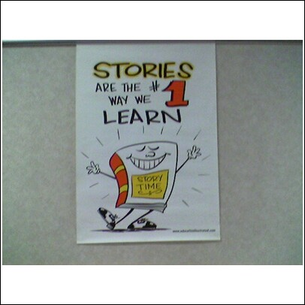
Teaching Proficiency Through Reading and
Storytelling
TPRS
An in depth study and exploration
Notes:
TPR Story telling is an engaging second language teaching methodology that involves creating, reading, and dramatizing stories in the classroom. It is highly interactive in that it involves physical gesturing that is paired with new vocabulary and phrases.

Slide 2
What is TPRS?
TPR Storytelling is a method for teaching foreign languages that was created and developed by Blaine Ray, a Spanish teacher in Bakersfield, California, in 1999.
TPRS evolved from classical TPR (Total Physical Response), which is a foreign language teaching methodology developed by James Asher. TPR utilizes a highly effective physical element and is based on his theory that second languages are acquired in the same way as our native languages. We listen to the language before we produce it, and physically respond to commands.
TPRS incorporates the kinesthetic elements of TPR, while adding a narrative and descriptive component.
Stories that contain the vocabulary and grammar introduced with physical gestures and body movements are developed and then dramatized in class.
Notes:
TPR Storytelling is a method for teaching foreign languages that was invented by Blaine Ray, a Spanish teacher in Bakersfield, California, in 1990. Concerned that his students were disinterested in the unexciting process of learning a language from a textbook, he began to use James Asher's Total Physical Response to teach Spanish. Asher says that students acquire their second languages as they acquired their first languages. Our students learn as babies learn. Therefore, we should not expect them to produce the language before they have had an ample amount of time to listen to it. Blaine experienced great success, and the students began to be excited about his class. Although TPR has been the most effective method for acquiring a second language since it was invented in the 1960s, Blaine found that after hitting the "TPR wall," he was unsure of what to do to move from the imperative to the narrative and descriptive modes of speech. He found that changing from commands to the third person singular allowed him to tell stories, a long-term memory technique. He found that asking the students to act out the parts of the characters in the stories preserved the highly effective physical element that had been so powerful in Classical TPR. As the technique was developed over the years, it became an all-encompassing method and methodology. The method combines Dr. James Asher's Total Physical Response (TPR) with Dr. Stephen Krashen's language acquisition strategies, allowing us to teach grammar, reading and writing along with vocabulary
TPR Storytelling is a method for teaching foreign languages that was invented by Blaine Ray, a Spanish teacher in Bakersfield, California, in 1990. Concerned that his students were disinterested in the unexciting process of learning a language from a textbook, he began to use James Asher's Total Physical Response to teach Spanish. Asher says that students acquire their second languages as they acquired their first languages. Our students learn as babies learn. Therefore, we should not expect them to produce the language before they have had an ample amount of time to listen to it. Blaine experienced great success, and the students began to be excited about his class. Although TPR has been the most effective method for acquiring a second language since it was invented in the 1960s, Blaine found that after hitting the "TPR wall," he was unsure of what to do to move from the imperative to the narrative and descriptive modes of speech. He found that changing from commands to the third person singular allowed him to tell stories, a long-term memory technique. He found that asking the students to act out the parts of the characters in the stories preserved the highly effective physical element that had been so powerful in Classical TPR. As the technique was developed over the years, it became an all-encompassing method and methodology. The method combines Dr. James Asher's Total Physical Response (TPR) with Dr. Stephen Krashen's language acquisition strategies, allowing us to teach grammar, reading and writing along with vocabulary
TPR Storytelling is a method for teaching foreign languages that was invented by Blaine Ray, a Spanish teacher in Bakersfield, California, in 1990. Concerned that his students were disinterested in the unexciting process of learning a language from a textbook, he began to use James Asher's Total Physical Response to teach Spanish. Asher says that students acquire their second languages as they acquired their first languages. Our students learn as babies learn. Therefore, we should not expect them to produce the language before they have had an ample amount of time to listen to it. Blaine experienced great success, and the students began to be excited about his class. Although TPR has been the most effective method for acquiring a second language since it was invented in the 1960s, Blaine found that after hitting the "TPR wall," he was unsure of what to do to move from the imperative to the narrative and descriptive modes of speech. He found that changing from commands to the third person singular allowed him to tell stories, a long-term memory technique. He found that asking the students to act out the parts of the characters in the stories preserved the highly effective physical element that had been so powerful in Classical TPR. As the technique was developed over the years, it became an all-encompassing method and methodology. The method combines Dr. James Asher's Total Physical Response (TPR) with Dr. Stephen Krashen's language acquisition strategies, allowing us to teach grammar, reading and writing along with vocabulary

Slide 3
Adapting the Textbook to tprs
Existing Foreign Language textbooks can easily be adapted for use in TPR Storytelling techniques.
Vocabulary and grammar being taught in the textbook are incorporated into the stories utilizing gestures, personalized mini situations and personalized questions and answers.
In addition to teaching grammar in the traditional way, grammar is taught in context and is called “pop up grammar”. The teacher poses quick questions and explanations of grammatical features as they relate to the story.
TPRS supports and enhances a standard language course.

Slide 4
Benefits of TPRS
Students are highly engaged and actively involved in the language learning. The TPRS class is dynamic, creative, and student-centered.
TPRS is highly effective . All studies and research indicate that TPRS students outperform students in traditional classes.
Research studies have demonstrated a high degree of student satisfaction with and preference to TPRS. In these studies, students have reported feeling interest, enthusiasm, happiness and success in class.
Studies have shown that schools are increasing enrollment numbers . High retention rates correlate to student satisfaction.
Vocabulary recall and retention is high, which enables students to make us of the new words and structures learned in class.
TPRS develops fluency with accuracy.

Slide 5

Language IN Motion
http://www.youtube.com/watch?v=y4oN1lXi17A&safety_mode=true&persist_safety_mode=1&safe=active

Slide 6
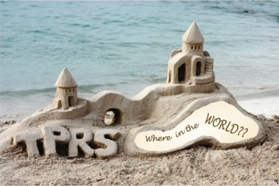
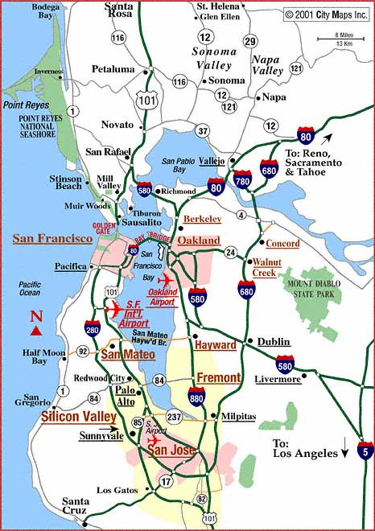
TPRS Mentors:
Laurie Rubin (Spanish teacher in Bodega Bay, CA)
Ben Lev (Spanish teacher in Santa Rosa, CA)
Sharon Bontrager (Spanish teacher in Napa, CA)
Greg Stevens (Spanish Teacher at Tamalpais School District in Marin, CA)
Brooks Geiken (Spanish Teacher in Berkeley, CA)
Julie Gilbert (Spanish teacher in San Ramon, CA)

Slide 7
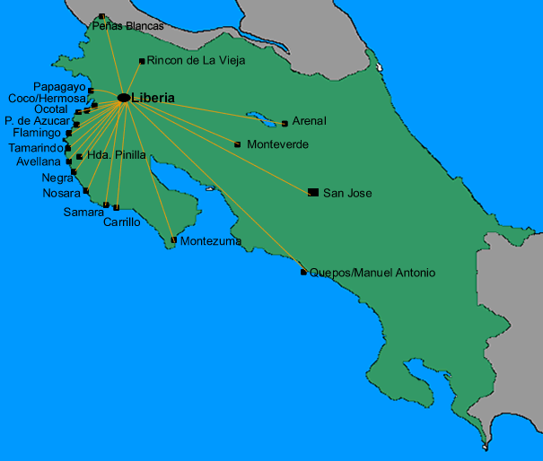

INSTITUTO ESTELAR BILINGUE
The Estelar Spanish program is located in Liberia, Costa Rica. It combines intensive, conversational Spanish classes using TPRS methodology with a wide variety of extracurricular activities. Teachers in the Estelar Spanish programed are trained in TPRS and boast classes that are highly engaging, dynamic and fun.
http://estelarcr.com/en/node/17

Slide 8
Project outcome and Documentation
ICSD students and staff will benefit from experiencing TPRS in many ways….
Communicative fluency will increase, and performance in reading, writing, speaking, and listening will improve.
Student will be more actively engage d in the language learning process. The TPRS experience has proven to be more enjoyable, therefore increasing the likelihood that they will continue foreign language study beyond the requirement.
Students will enjoy the experience of establishing pen pal relationships and a classroom connection with a school in Liberia, Costa Rica. This will add purpose and meaning to their language learning experience as well as raise cultural awareness.
ICSD World Language teachers will have access to more information about TPRS and access to relevant materials that I will make available to them by sharing in PLC meetings . I will establish a lending library of books and materials, as well as resource kit with notes, handouts and video footage.

Slide 9
Research

Slide 10
Timeline
September-February:
Each month I will work with a different TPRS mentor. I will carefully observe classes, taking observation notes and collecting materials, stories and resources that each mentor makes available to me.
I will attend all local TPRS support groups, meetings, workshops and conferences in the Bay Area.
I will visit Command Performance Language Institute in Berkeley, CA several times to explore the TPRS materials and build my collection of story books, software, and other resources.
March:
I will attend Instituto Estelar Bilingue in Liberia, Costa Rica for three-four weeks. I will participate in an advanced level immersion course, and volunteer at a local school.
April-June:
I will attend at least one National TPRS conference, preferable given by Bryce Hedstrom or Carol Gaab.
  Testimonial of Bryce’s work: “I took a sabbatical last year and observed some of the best TPRS classrooms in the country. One of them was Bryce Hedstrom. Observing Bryce's classroom has impacted my methods and practices-especially in reading and classroom management. Because of Bryce, a major emphasis in my classroom is now reading! Several TPRS teachers are blogging and promoting the value of reading in the second language classroom. In Bryce's classroom I saw an effective reading program in action
  -Mary Schirber, Minnesota
I will work on my TPRS resource kit to share with my colleagues at ICSD.

